Slide 1
Graphs Algorithms - Depth First Search

Slide 2
Introduction
A graph G is represented as : G = (V, E), where |V| is the number of vertices |E| is the number of edges in a graph.
There are two standard ways to represent a graph G = (V,E): as a collection of adjacency matrix or as adjacency list
Either way applies to both directed and undirected graphs.

Slide 3
Introduction
1
2
3
4
5
1
2
1
2
5
1
0
1
0
0
1
2
1
5
3
4
2
1
0
1
1
1
3
3
2
4
3
0
1
0
1
0
5
4
4
2
5
3
4
0
1
1
0
1
5
4
1
2
5
1
1
0
1
0
1
2
3
4
5
6
1
2
3
1
2
4
1
0
1
0
1
0
0
2
5
2
0
0
0
0
1
0
3
6
5
3
0
0
0
0
1
1
4
5
6
4
2
4
0
1
0
0
0
0
5
4
5
0
0
0
1
0
0
6
6
0
0
0
0
0
1
6

Slide 4
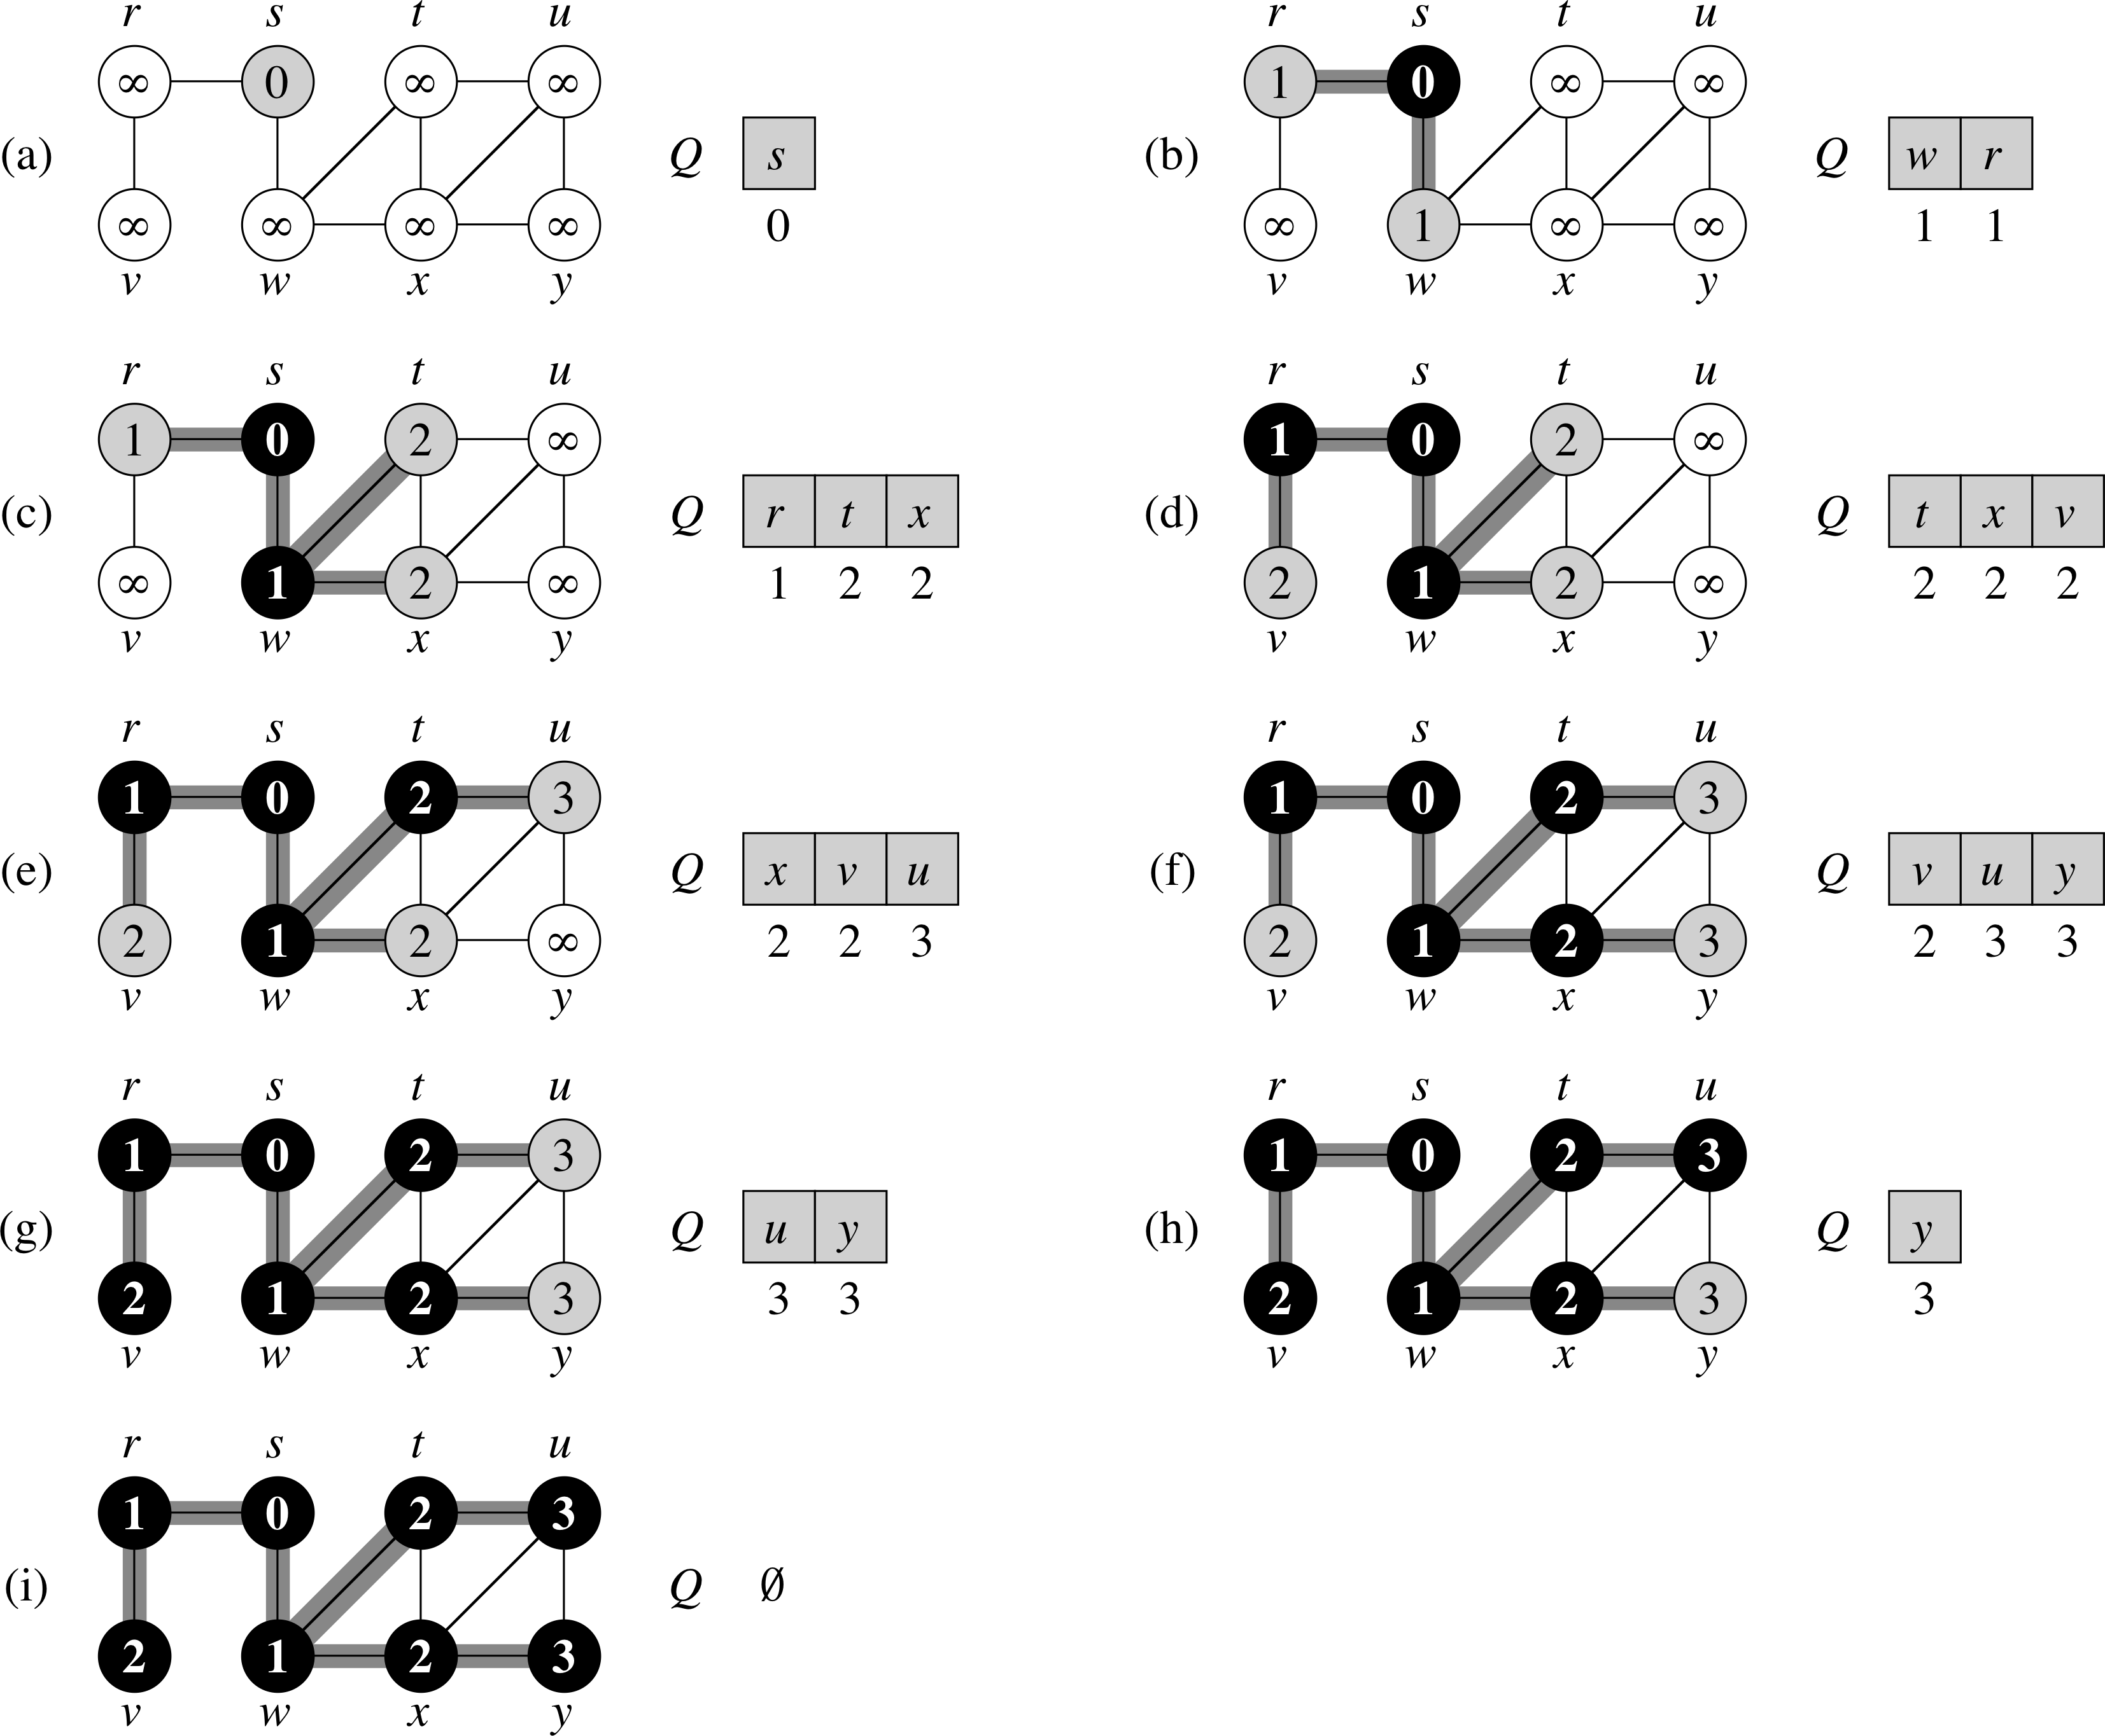
Breadth-first search

Slide 5
Depth-first search
It searches “deeper” in the graph whenever possible.
Depth-first search explores edges out of the most recently discovered vertex, v that still has unexplored edges leaving it.
Once all of v’s edges have been explored, the search “back-tracks” to explore edges leaving the vertex from which v was discovered.
This process continues until we have discovered all the vertices that are reachable from the original source vertex.
If any undiscovered vertices remain, the DFS selects one of them as a new source, and it repeats the search from that source.
The algorithm repeats this entire process until it has discovered every vertex.s

Slide 6
Depth-first search
Whenever depth-first search discovers a vertex v during a scan of the adjacency list of an already discovered vertex u.
It records this event by setting v’s predecessor attribute v.π to u.
Unlike breadth-first search, whose predecessor subgraph forms a tree, the predecessor subgraph produced by a depth-first search may be composed of several trees, because the search may repeat from multiple sources.

Slide 7
Depth-first forest
We define the predecessor subgraph of a depth-first search slightly differently from that of a breadth-first search: we let Gπ = (V, Eπ) where Eπ = {(v.π, v): v∈ V and v.π ≠ NIL}
The predecessor subgraph of a depth-first search forms a depth-first forest comprising several depth-first trees. The edges in Eπ are tree edges.

Slide 8
Depth-first
Depth-first search colors vertices during the search to indicate their state.
Each vertex is initially white, is grayed when it is discovered in the search, and is blackened when it is finished.
This technique guarantees that each vertex ends up in exactly one depth-first tree, so that these trees are disjoint.
DFS also timestamps each vertex.

Slide 9
Depth-first
Each vertex has two timestamps : the first timestamp v.d records when v is first discovered (and grayed), and the second timestamp v.f records when the search finishes examining v’s adjacency list.
These timestamps provide important information about the structure of the graph.
The DFS records when it discovers vertex u in the attribute u.d and when it finishes vertex u in the attribute u.f.
These timestamps are integers between 1 and 2|V|

Slide 10
Depth-first
For every vertex u, u.d < u.f Vertex u is white before time u.d, gray between time u.d and time u.f, and BLACK thereafter.

Slide 11
Depth-First Search
DFS-VIST(G,u) time = time + 1 u.d = time u.color = GRAY
for each v ∈ G.Adj[u] if v.color == WHITE v.π = u DFS-VISIT(G, v) u.color = BLACK time = time + 1 u.f = time
DFS (G) for each vertex u ∈ G.V u.color = WHITE u.π = NIL time = 0 for each vertex u ∈ G.V if u.color == WHITE DFS-VISIT(G, u)

Slide 12
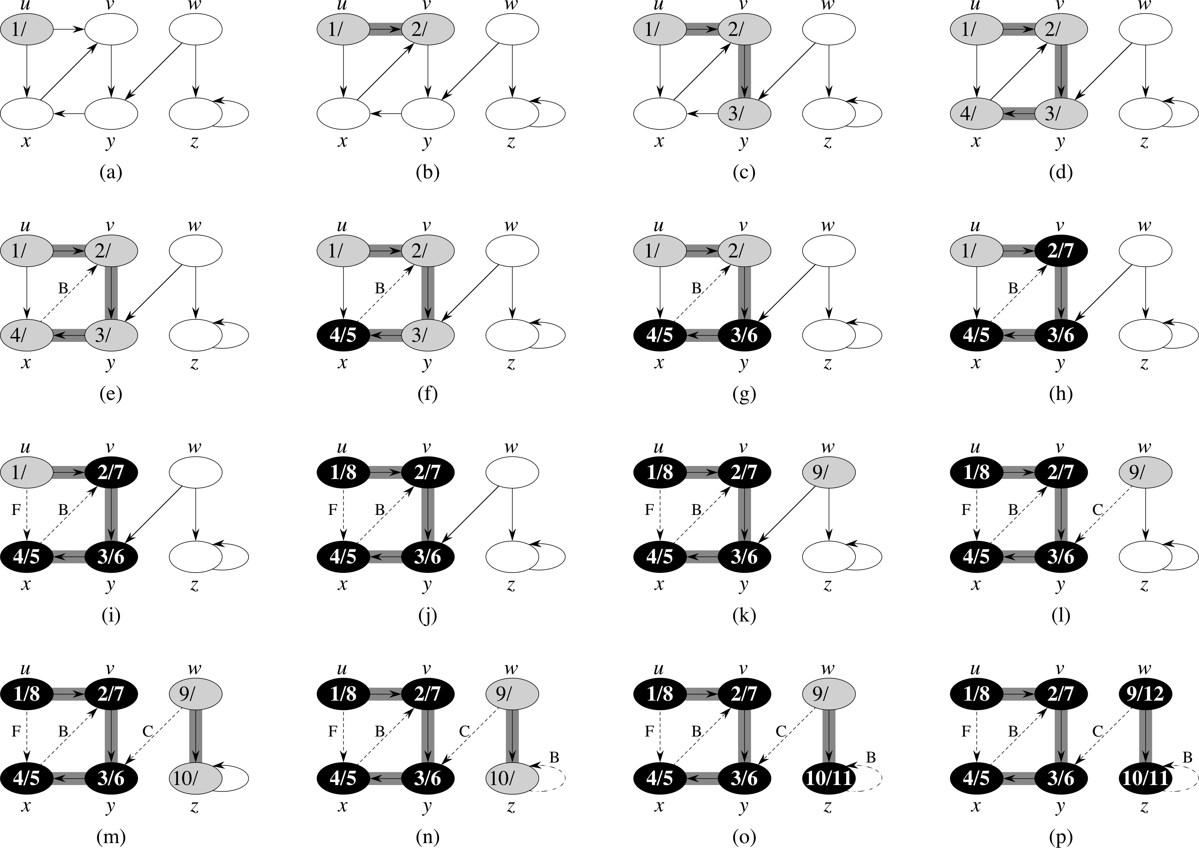
Depth-First Search

Slide 13
Depth-first Search
Initially all vertices are white and the π attributes to NIL.
The global time counter is set to 0.
Every time DFS-visit(G, u) is called vertex u becomes the root of a new tree in the depth-first forest.
When DFS returns, every vertex u has been assigned a discovery time u.d and a finishing time u.f
In each call DFS-VISIT(G,u) vertex u is initially white.
Examine each vertex v adjacent to u and recursively visit v if it is white.
As each vertex v ∈ Adj[u] is considered, we say that the edge (u,v) is explored by the depth-first search.
After every edge leaving u has been explored, paint u black, increment time, and record the finishing time in u.f.

Slide 14
Depth-first Search
The results of depth-first search may depend upon the order in which DFS examines the vertices and upon the order in which DFS-VISIT visits the neighbors of a vertex.
Running time is θ(V + E)

Slide 15
Topological Sort
DFS can be used to perform a topological sort of a directed acyclic graph, or a “dag”.
A topological sort of a dag, G = (V,E) is a linear ordering of all its vertices such that if G contains an edge(u,v), then u appears before v in the ordering.
We can view a topological sort of a graph as an ordering of its vertices along a horizontal line so that all directed edges go from left to right.

Slide 16
Directed Acyclic Graphs
Many applications use directed acyclic graphs to indicate precedences among events.
We will look at an example that arises when a person gets dressed in the morning.
The person must don certain garments before others (e.g., socks before shoes).
Other items may be put on in any order (e.g., socks and pants).
A directed edge (u,v) in the dag indicates that garment u must be donned before garment v.
A topological sort of this dag therefore gives an order for getting dressed.

Slide 17
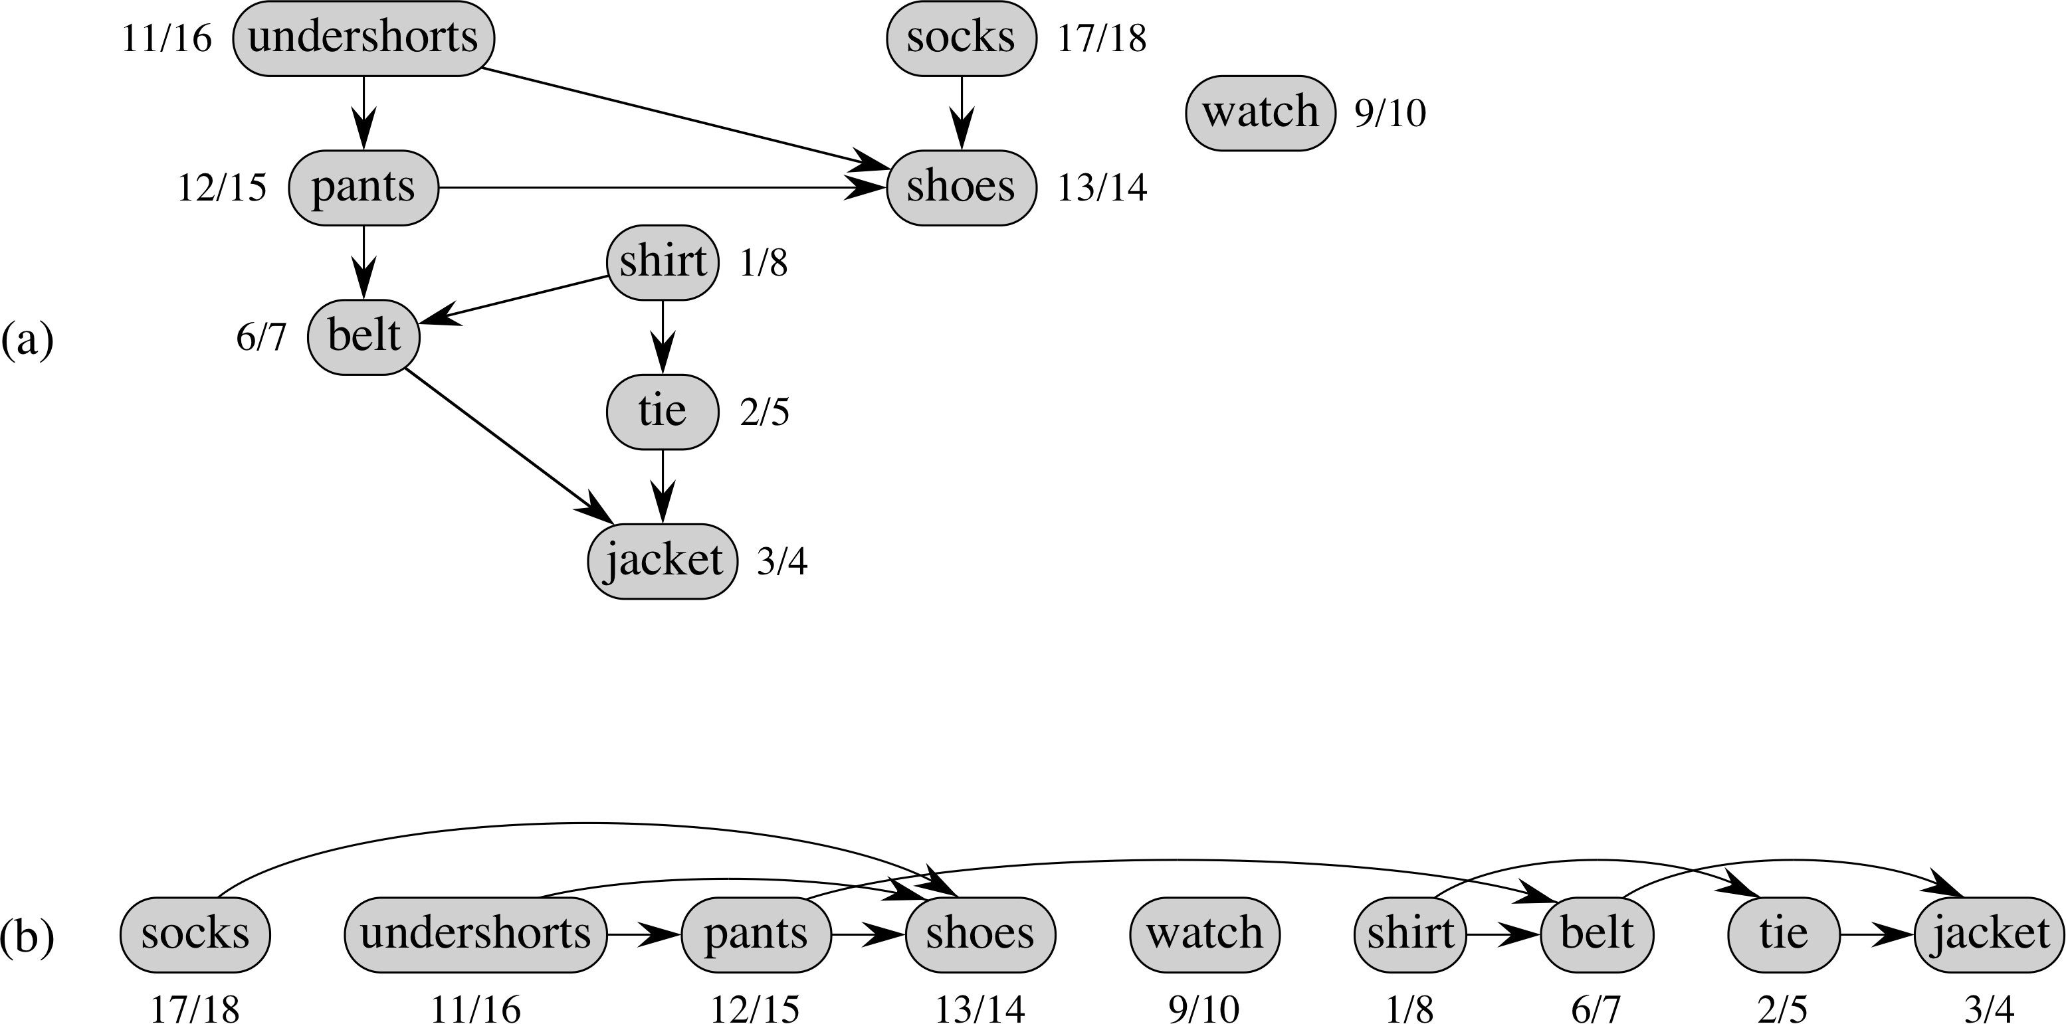

Slide 18
Directed Acyclic Graphs
Topological-Sort(G) call DFS(G) to compute finishing times v.f for each vertex v as each vertex is finished, insert it onto the front of a linked list return the linked list of vertices.

